Slide 1
TEACHER CUE
CFU
HINT
Scaffolding for students
MAKE THE CONNECTION
Allow students to make the connection

Slide 2
I will be able to describe the function of major body systems
TRACK WITH ME
READ WITH ME
I can name different body systems
I can describe the function of different organs involved in an organ system

Slide 3

I will be able to describe the function of major body systems
Brainstorm time
What are the different body systems that you remember?
What organs make up each of the systems?
End

Slide 4
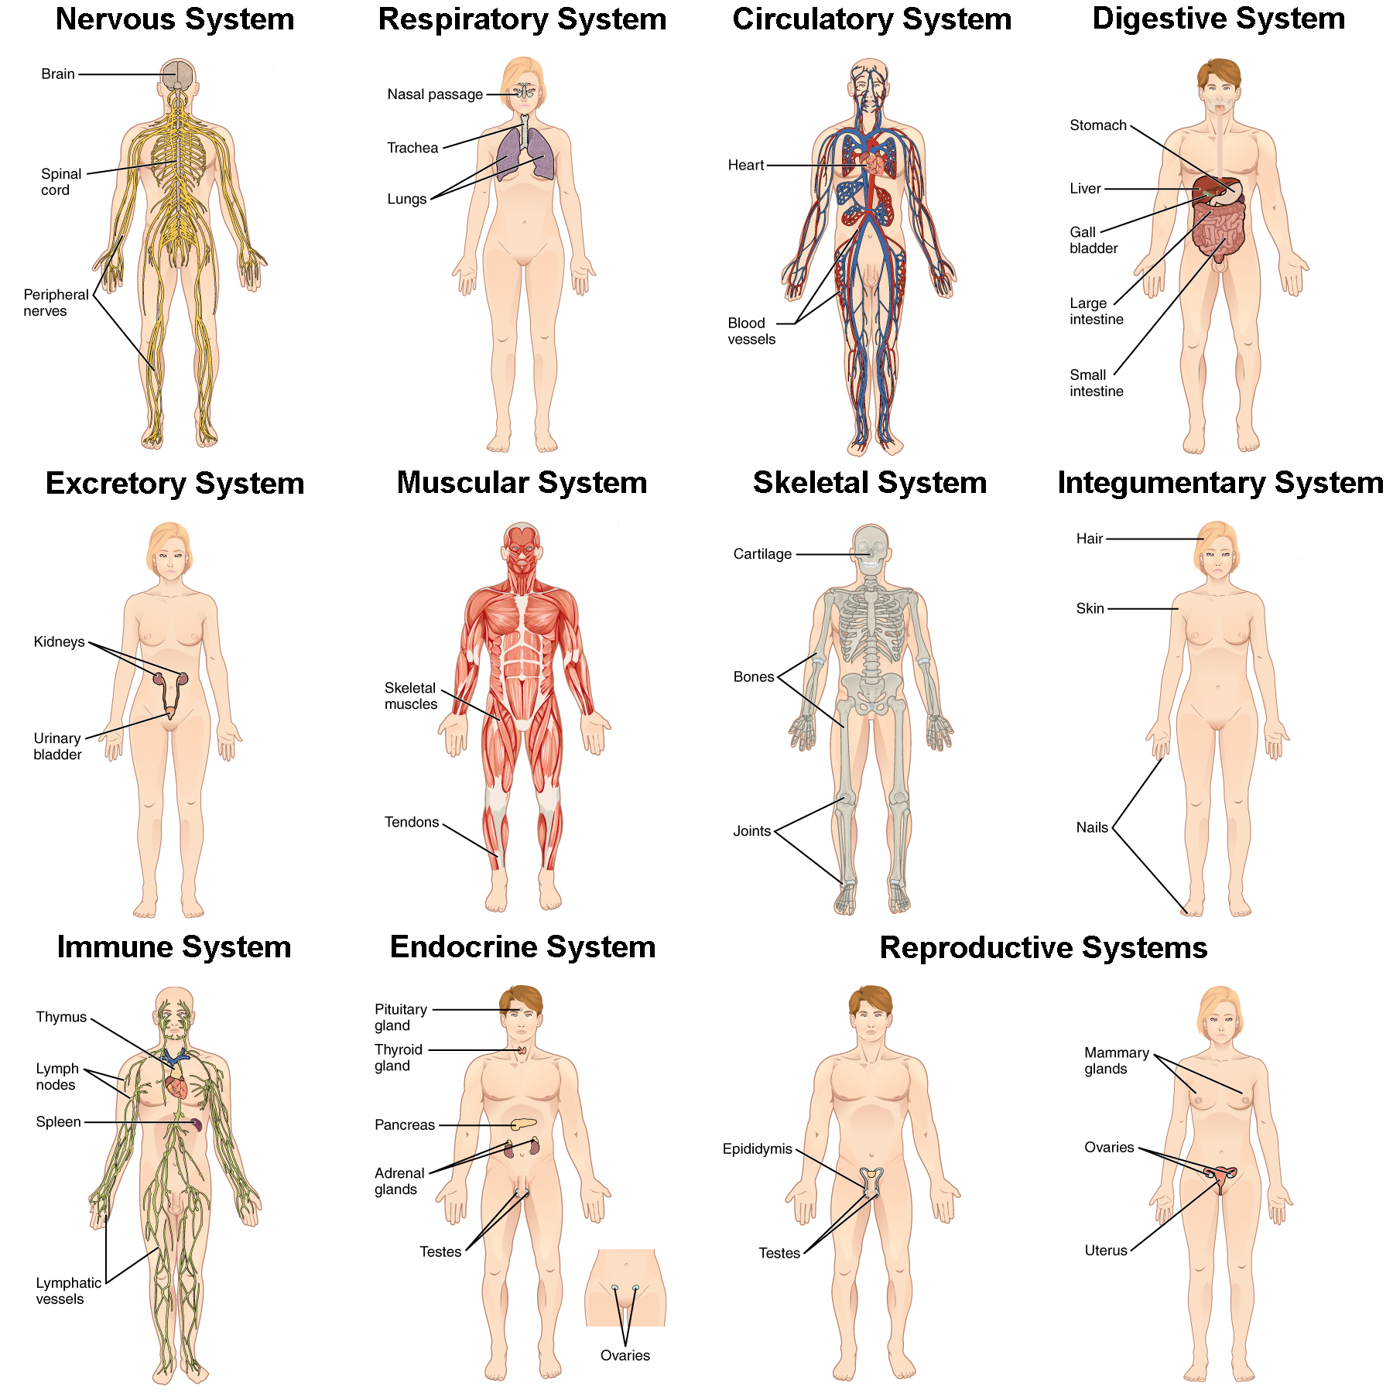
I will be able to describe the function of major body systems
Of the organ systems displayed which do you not recognise?
Year 8- Digestive, circulatory, reproductive, excretory, respiratory
Year 9- Nervous system, immune system and endocrine system

Slide 5
I will be able to describe the function of major body systems
Today: Revision of body systems from year 8!

Slide 6
Circulatory System
The Circulatory system that is responsible for carrying blood, nutrients, and waste throughout the body.
The system is made up of 3 independent systems that work together cardiovascular (heart), pulmonary (lungs) and systematic (arteries, veins and vessels).

Slide 7
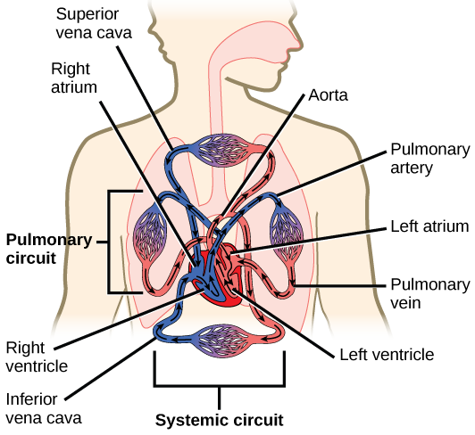
I will be able to describe the function of major body systems

Slide 8
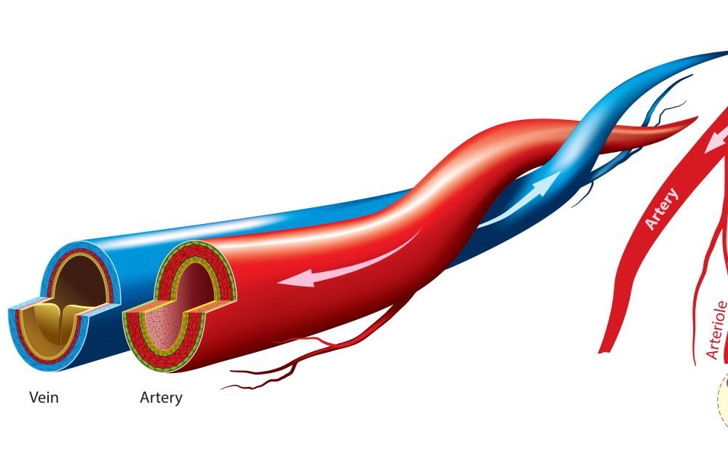
I will be able to describe the function of major body systems
Arteries move oxygenated blood away from the heart and are coloured red.
Veins move deoxygenated blood towards the heart and are coloured blue.

Slide 9
I will be able to describe the function of major body systems
Aorta
The aorta is a major artery that carries blood to the systemic circulatory system.
The Atrium is the upper chamber of the heart, whereas the ventricle is the lower chamber of the heart.

Slide 10
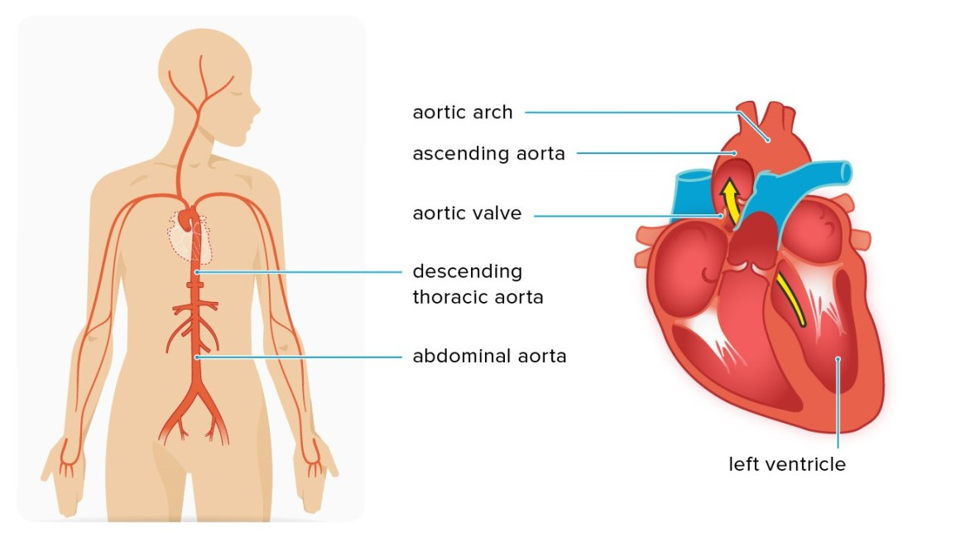

Slide 11
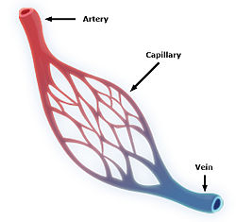
I will be able to describe the function of major body systems
Capillary
Small blood vessel that allows nutrient exchange

Slide 12
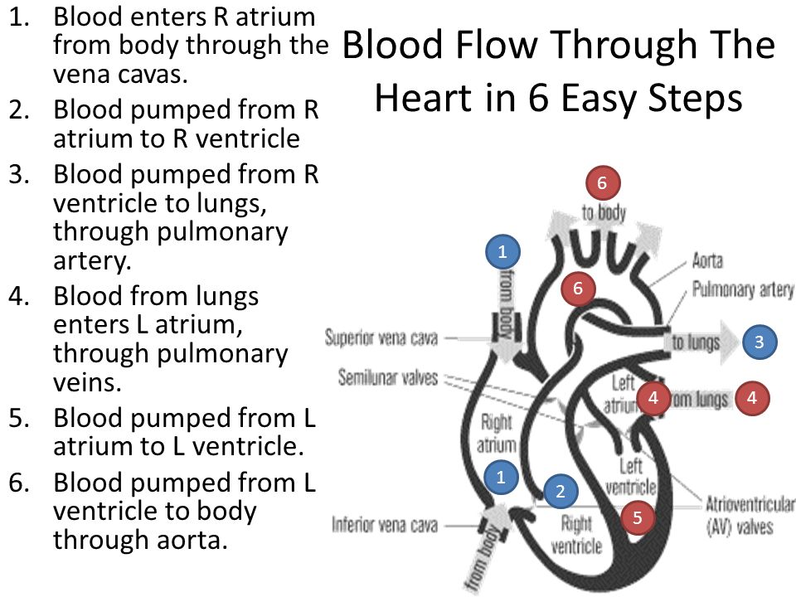

Slide 13
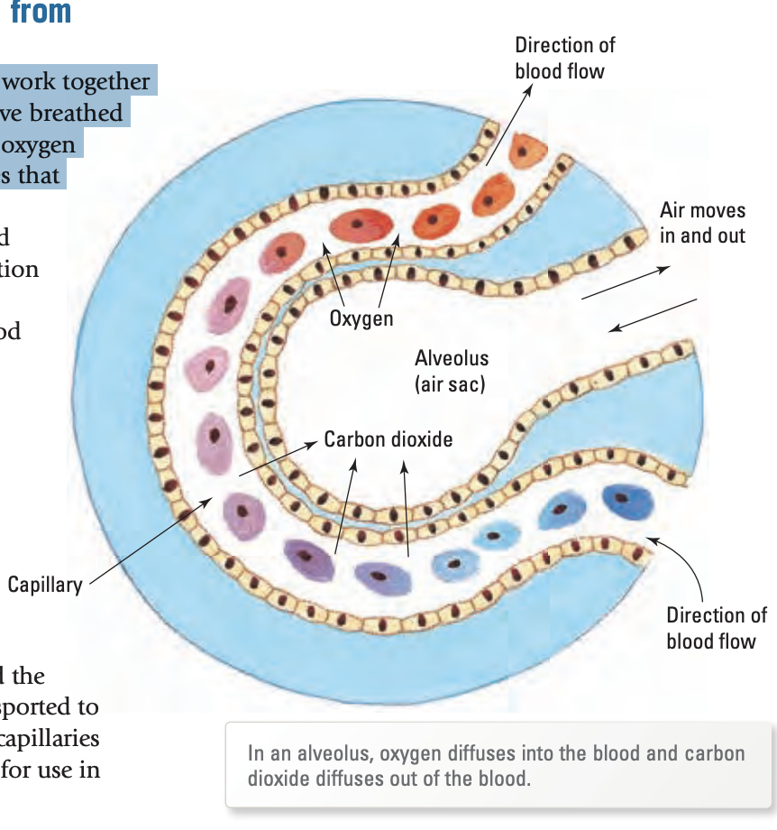
I will be able to describe the function of major body systems
Respiratory system
The organ that links the circulatory and the respiratory system is the alveoli.
Once you have breathed in and oxygen has reached your alveoli, oxygen diffuses into red blood cells in capillaries that surround the alveoli.

Slide 14
I will be able to describe the function of major body systems
Digestive system
This is the system made up of the gastrointestinal tract, mouth, esophagus, mouth, stomach, gall bladder, small intestine and large intestine.
Activity: In groups find the function of one of these parts and be ready to share with the class.

Slide 15
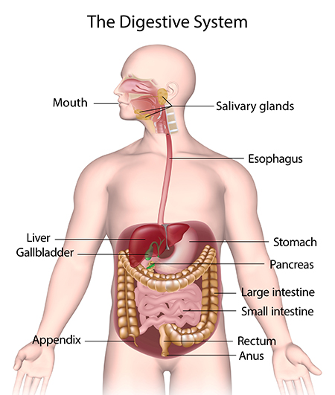
I will be able to describe the function of major body systems
Gastrointestinal Tract
Series of hollow organs joined in a long twisting tube from the mouth to the anus.
Esophagus
Once start swallowing brain signals muscles esophagus.
Sphincter stays closed and stops contents of stomach flowing back to esophagus.

Slide 16
I will be able to describe the function of major body systems
Stomach
After food enters your stomach mixes liquids and food
Stomach slowly empties contents into small intestine.
Gallbladder
Stores bile which is produced by the liver to help with digestion

Slide 17
I will be able to describe the function of major body systems
Small intestine
Mixes food with digestive juices
Waste products of digestive process to large intestine.
Large intestine
Absorbs water and changes waste from a liquid to a stool

Slide 18
I will be able to describe the function of major body systems
Anus
Rectum stores stool and pushes it out of your anus during a bowel movement.
Pancreas
Secretion of substances which help with digestion.

Slide 19
I will be able to describe the function of major body systems
MAKE THE CONNECTION
Which parts of the body make up the excretory system?
Excretory system
The excretory system is the system that removes waste from the body.
Regulates the chemical composition of body fluids
Removes metabolic waste
Retains proper amount of water, salts and nutrients

Slide 20
I will be able to describe the function of major body systems
Activity:
1) Can you create a graphic organiser of the different body systems.

Slide 21
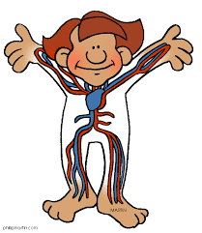
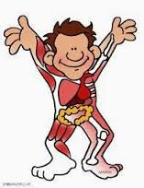
I will be able to describe the function of major body systems
Body System | Important Organs | How does this body system help you? (function)

Slide 22
I will be able to describe the function of major body systems
Exit ticket
Based on what we have learnt today
If you were going to teach this lesson to younger students, what would you identify as the key things they would need to know?
Notes:
Please include tasks/questions here rather than just referring to a worksheet. This will save on photocopying and facilitate sharing with other schools.
Try and build tasks/questions which escalate through Bloom’s Taxonomy. This will help with differentiation.

Slide 23
I will be able to describe the function of major body systems
TRACK WITH ME
READ WITH ME
I can name different body systems
I can describe the function of different organs involved in an organ system

